Slide 1
PySpark on Kubernetes: Word Count+ PageRank
20097 - Zeynep Salihoglu

Slide 2
INTRODUCTION
GCP Platform used for this project
Technologies: GKE and PySpark
Functions: Word Count and Page Rank

Slide 3
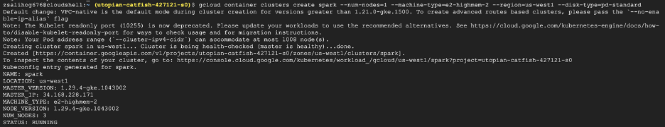
IMPLEMENTATION
Create a cluster on GKE
gcloud container clusters create spark --num-nodes=1 --machine-type=e2-highmem-2 --region=us-west1 --disk-type=pd-standard

Slide 4
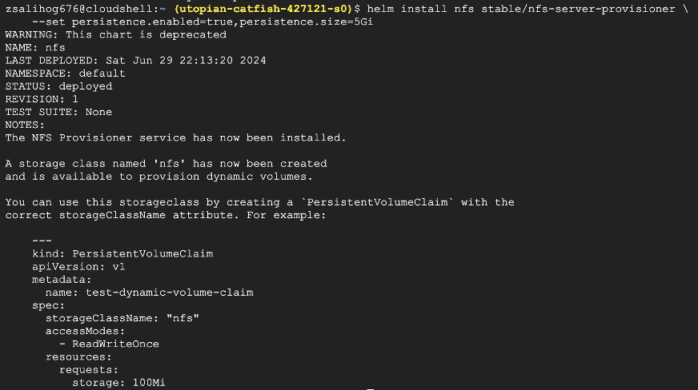
2. Install the NFS Server Provisioner
helm repo add stable https://charts.helm.sh/stable
helm install nfs stable/nfs-server-provisioner \
--set persistence.enabled=true,persistence.size=5Gi

Slide 5
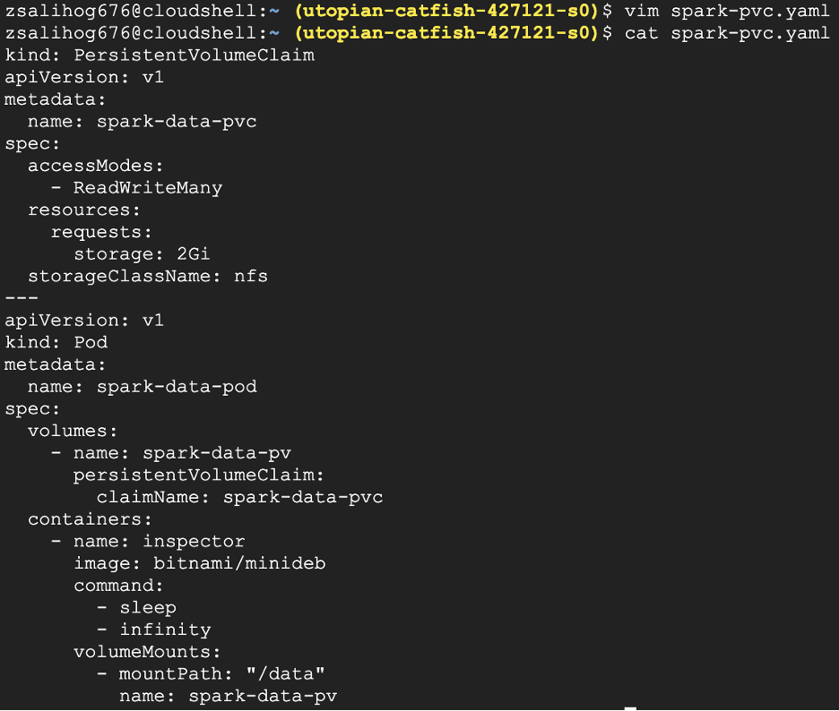
3. Create a persistent disk volume and a pod to use NFS

Slide 6
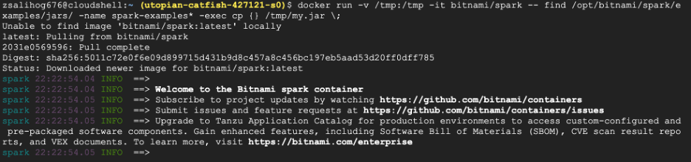
4. Apply the above yaml descriptor
kubectl apply -f spark-pvc.yaml
5. Create and prepare your application JAR file
docker run -v /tmp:/tmp -it bitnami/spark -- find /opt/bitnami/spark/examples/jars/ -name spark-examples* -exec cp {} /tmp/my.jar \;

Slide 7
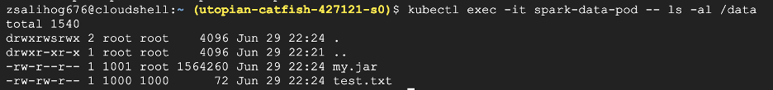
6. Add a test file with a line of words that we will be using later for the word count test
echo "how much wood could a woodpecker chuck if a woodpecker could chuck wood" > /tmp/test.txt
7. Copy the JAR file containing the application, and any other required files, to the PVC using the mount point
kubectl cp /tmp/my.jar spark-data-pod:/data/my.jar
kubectl cp /tmp/test.txt spark-data-pod:/data/test.txt
8. Make sure the files a inside the persistent volume
kubectl exec -it spark-data-pod -- ls -al /data

Slide 8
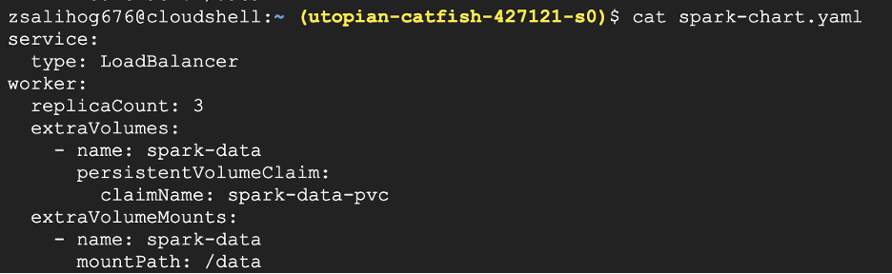
9. Deploy Apache Spark on Kubernetes using the shared volume spark-chart.yaml:

Slide 9
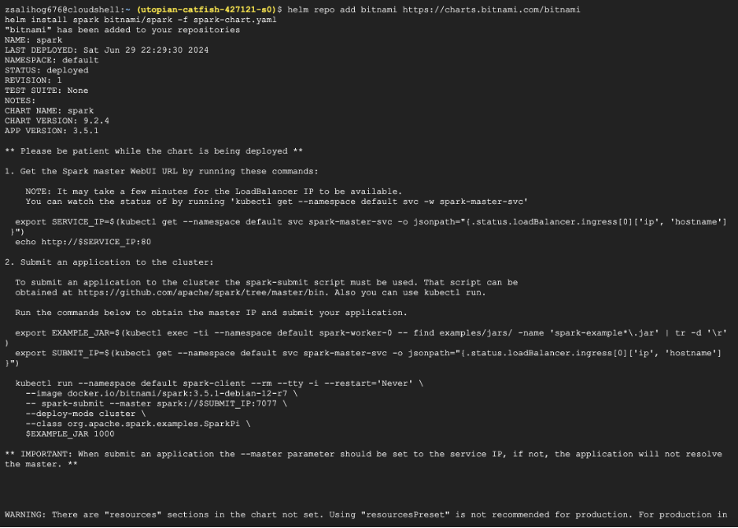
10. Deploy Apache Spark on the Kubernetes cluster using the Bitnami Apache Spark Helm chart and supply it with the configuration file above
helm repo add bitnami https://charts.bitnami.com/bitnami
helm install spark bitnami/spark -f spark-chart.yaml

Slide 10
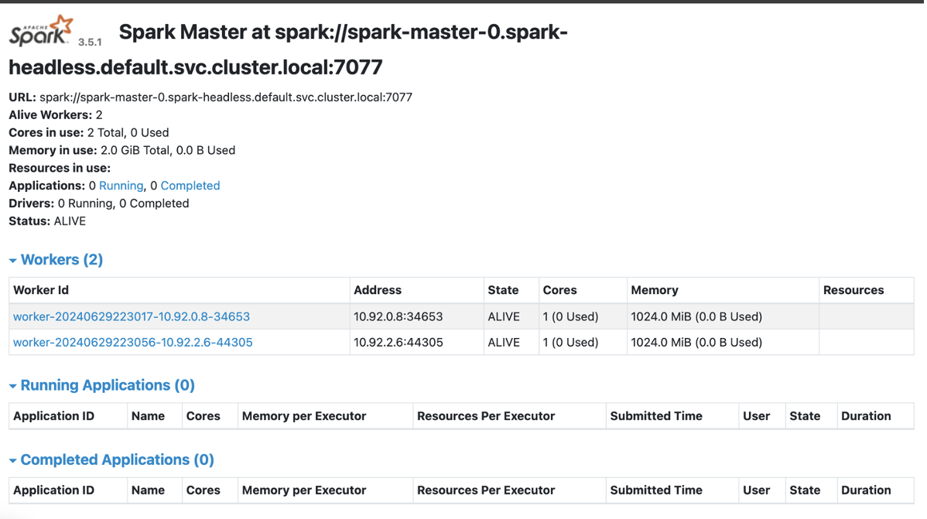
11. Get the external IP of the running pod
kubectl get svc -l "app.kubernetes.io/instance=spark,app.kubernetes.io/name=spark"
12. Open the external ip on your browser: http://35.199.151.79

Slide 11
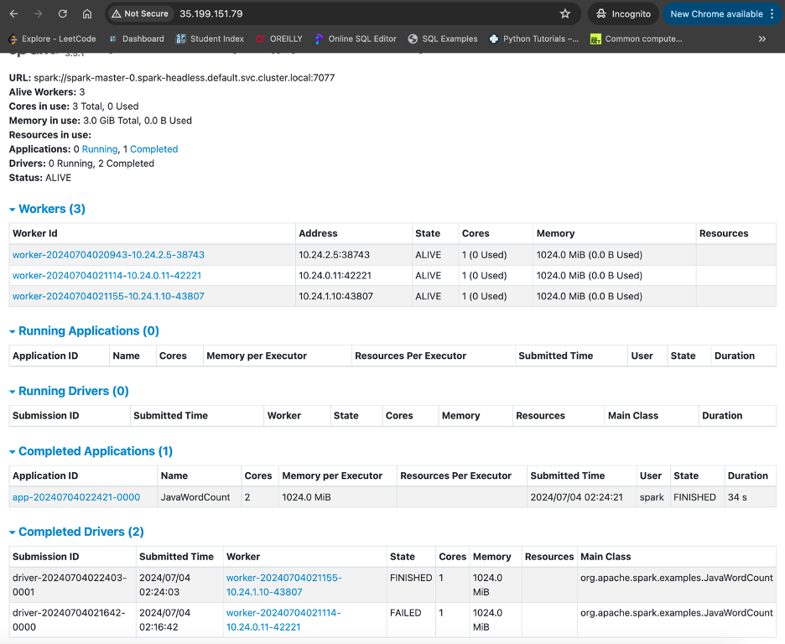
TEST
Submit a word count task :
kubectl exec -it spark-master-0 -- spark-submit --master spark://35.199.151.79:7077 --deploy-mode cluster --class org.apache.spark.examples.JavaWordCount /data/my.jar /data/test.txt
And on your browser, you should see this task finished

Slide 12
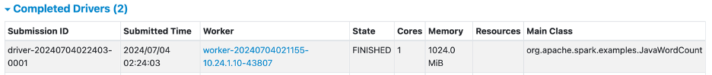
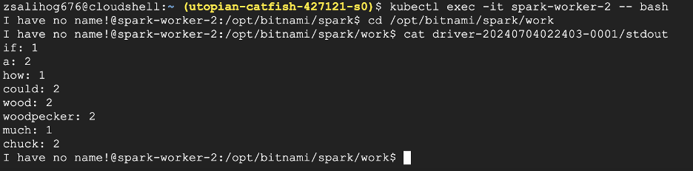
Task is finished:
kubectl get pods -o wide | grep WORKER-NODE-ADDRESS
kubectl get pods -o wide | grep 10.24.1.10
kubectl exec -it <worker node name> -- bash
kubectl exec -it spark-worker-2 -- bash
cd /opt/bitnami/spark/work
cat driver-20240704022403-0001/stdout

Slide 13
CONCLUSION
Word Count and PageRank apps show how integrating PySpark with Kubernetes provides a stable foundation for scalable and effective big data processing.
PySpark is responsible for distributed processing of big datasets, while Kubernetes ensures high availability and fault tolerance by dynamically managing resources.

